Slide 1
Chef
DevOps Course

Slide 2
Objectives
By the end of this session
You’ll be familiar with Chef tool
You’ll be familiar with the cookbook components
You’ll be familiar with basic nodes management with Chef
Hope we’ll get there - Test kitchen, data bags, chef vault, knife plugins, supermarket

Slide 3
Chef is a Tool
Learning Chef is like learning the basics of a language
80% fluency will be reached very quickly
The remaining 20% just takes practice
The best way to learn Chef is to use Chef

Slide 4
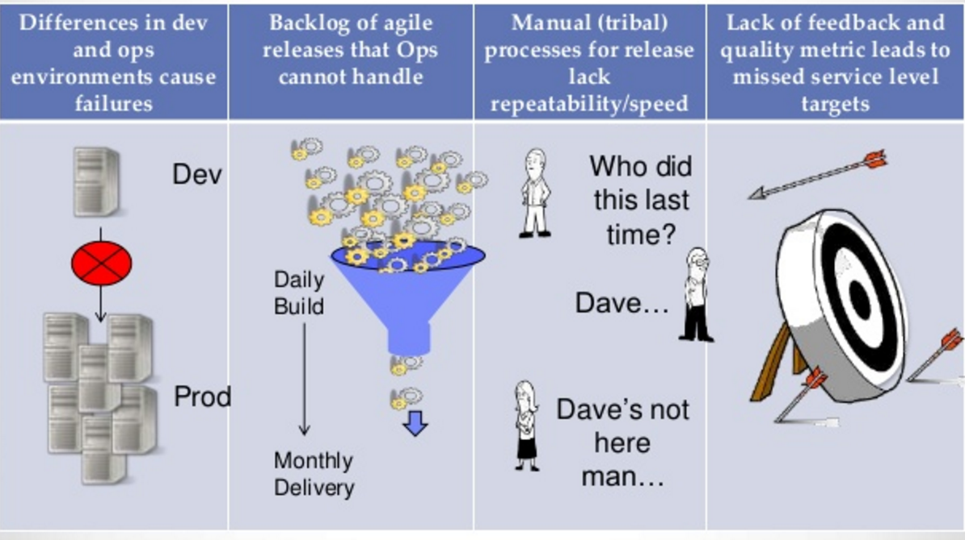
Chef
Notes:
לפני שפורד המציא את פס הייצור (אוטומציה של בניה אנושית) אנשים היו בונים 1. נפרד בין סביבות (מכונית אחת פחות מוקפדת מאחרת) 2. כמות בניות מוגבלת לפי אנשים ויכולתם 3. אם מישהו בצוות חולה – כל פס הייצור יכול להאט/להיעצר 4. מי הידק את הבורג ההוא? התקינו בכלל? זוכרים מה קרה? --- היום טכנאים מתכנתים פעם אחת רובוטים שבונים הרבה סביבות לפי סט הגדרות אמין אחד.

Slide 5
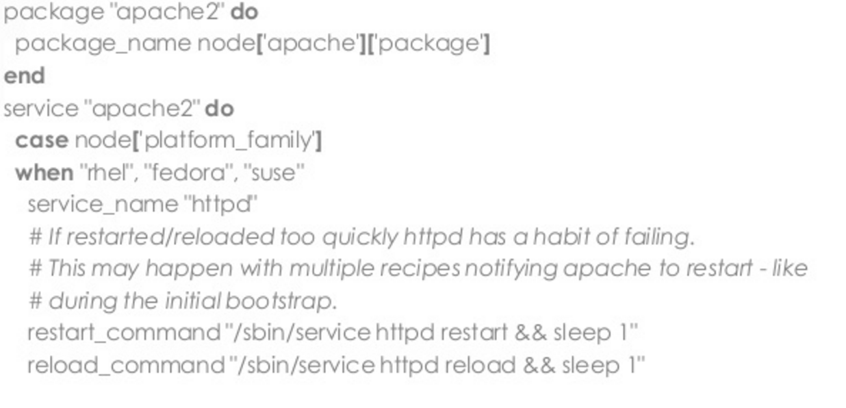
Infrastructure as a Code (IaC)

Slide 6
We Need a New Way to Work
Infrastructure needs to be
Repeatable
Testable
Scalable

Slide 7
Chef is . . .
A library for Configuration Management
A Configuration Management System
A Systems Integration Platform
An API for your entire infrastructure
Open-source!
Notes:
מרכז לסטים של קונפיגורציה (ספרים)
מערכת שמבצעת החלה ופידבק של הגדרות על/מinfrastructure
דיבור בין מערכות, שינוי הגדרות באחת לפי דרישה מאחרת
declarative definitions

Slide 8
How Chef Works
Cookbooks
Data Bags
Attributes
Chef
Server
DEV
QA
PROD
Workstation VM
Notes:
*
*

Slide 9
How Chef Works
DEV, QA, PROD Servers Supposed to have the same configuration
DEV
==
QA
==
PROD
Is this humanly possible without Chef?
…I don’t think so
Notes:
*

Slide 10
How Chef Works
Chef client runs on each Server
They talk to the Chef Server
Chef can also run without a server, chef-solo
Notes:
*

Slide 11
We call each system you configure a Node
Notes:
*
Quick run of Exercise 1, chef solo – recipes structure and chef-client –z recipe.rb

Slide 12

Recipes
package "build-essential" do action :install end user node[:redis][:user] do action :create system true shell "/bin/false" end directory node[:redis][:dir] do owner "root" mode "0755" action :create end directory node[:redis][:data_dir] do owner "redis" mode "0755" action :create end
Resources
Attributes
Notes:
*
https://github.com/nashpaz/chefJB

Slide 13
Attributes are Searchable
$ knife search node ‘jdk_version:1.7’
# returns list of nodes with jdk 1.7
search(:node, ‘java_version:1.7’)
Notes:
*

Slide 14
Nodes have run_list
“run_list”: {
“recipe[java]”,
“recipe[jboss]”,
“role[internal]”
}
Notes:
*

Slide 15
Nodes have Roles
Roles describe what a node should be
Notes:
*

Slide 16
Roles are Searchable
$ knife search role ‘max_children:50’ search(:role, ‘max_children:50’)
Notes:
*

Slide 17
Roles Have a run_list
What roles or recipes to
apply in order
Notes:
*

Slide 18
Roles Have a run_list
Chef manages resources on nodes - e.g file, package, service
Resources are specified in recipes
Recipes are stored in cookbooks – along with templates, metadata, ,,,,,
A node’s run_list specifies which recipes (and thus resources) are applied
Notes:
*

Slide 19
Client / Server
Chef
Server
Nodes report their attributes to the Chef-server with the ‘Node’ object
Chef Repository
attributes
Nodes
DEV
QA
PROD
Notes:
*
*

Slide 20
Client / Server
Chef
Server
Server applies roles and sends run_list, roles, and all cookbooks back to clients
Chef Repository
run_list,
roles,
cookbooks
Nodes
DEV
QA
PROD
Notes:
*
*

Slide 21
Skinny Server, Fat Clients
No “builds” are done on the server
A Node configures itself based on its run_list and the downloaded cookbooks
Notes:
*

Slide 22
Recipes
package "build-essential" do action :install end user node[:redis][:user] do action :create system true shell "/bin/false" end directory node[:redis][:dir] do owner "root" mode "0755" action :create end directory node[:redis][:data_dir] do owner "redis" mode "0755" action :create end
Notes:
*

Slide 23
Cookbooks are packages for Recipes
Notes:
*

Slide 24
Cookbook Components
Attributes
Recipes
Metadata
Assets (files/templates)
Notes:
*

Slide 25
Sharing is beautiful
200+ high-quality cookbooks on community.opscode.com and growing all the time
Easy to customize existing cookbooks
Chef’s real value is this collection of cookbooks
Notes:
*
Exercise 2 – wstation, node and server, knife, run list,

Slide 26

Knife
Interface between a local repo and the Chef server
Manage Nodes, Cookbooks and recipes, Roles, data bags, Environments and more
Searching indexed data on the Chef server
Knife plugins

Slide 27
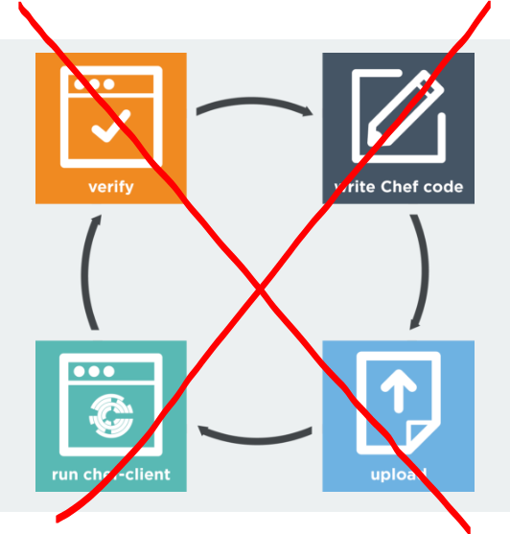
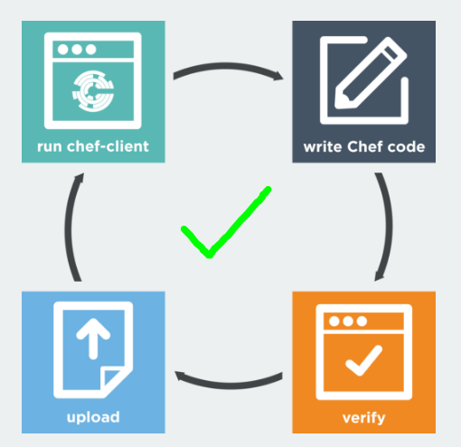
Test kitchen
Test infrastructure – verify your cookbooks before applying to actual infra

Slide 28
Data Bags
Data Bags are arbitrary stores of globally available JSON data
Think of them as global variables/data structures for your infrastructure
Notes:
*

Slide 29
Data Bags have Items
Data bag users/john
{
"comment": “postgres Rul3z",
"groups": [“"sysadmins", "postgres" ],
"ssh_keys": "ssh-rsa …..",
"id": “john",
"shell": "/bin/bash"
}
Notes:
*

Slide 30
Data Bags are Searchable!
pg_users = search(:users, “groups:postgres”)
group “postgres” do
members pg_users
end
Notes:
*

Slide 31
Code/data Split
Attributes
Recipes
Node Object
Role
Cookbook
Templates
run_list
Data Bags
Role
Node Object
Environments
The fact that attributes are in cookbooks, roles, environments, and the node itself can be confusing
Notes:
*

Slide 32
Tools
Chef web interface – Pretty!
Ohai – collects information about node
Knife – command-line tool
Shef – interpreter for working with cookbooks
git - not part of chef, but hard to use chef without also using git
Notes:
*

Slide 33
Summary
Resource
Recipe
Node
Run List
Search

